Slide 1
C372 Payment Technologies
Final Assessment Graded Assignment Briefing

Slide 2
FA Graded Assignment
The Final Assessment is in the form of Graded Assignment
This is an INDIVIDUAL assignment.
Milestone submissions in SA3.0
There will be a project interview in week 12
If you have a valid LOA on the interview date, please inform your lecturer to reschedule.

Slide 3
IMPORTANT
This assignment is a INDIVIDUAL assignment.
Class time will be allocated to work on GA
However, you should continue to work on the GA at your own time to improve on your work
Read through the entire document before you begin.

Slide 4
IMPORTANT
If you need to clarify any points in the assignment or think there is an error, speak to your lecturer.
You may ask questions to clarify concepts just like in the regular class, but the logic and code for the assignment should come from you, NOT your lecturer.
Your lecturers will NOT debug your code or tell you what to code.
You MUST be prepared to do the following during the interview:
  Explain your design decisions and the reasons behind them.
  Walk through the process flow and explain specific parts of your code and the underlying logic.
  Describe how you used AI, including the tools and prompts used, and how you checked, adapted, or integrated its responses.
  Reflect on which AI responses were useful, which were not, and why.
  Demonstrate your understanding by modifying the program and explaining your changes.

Slide 5
IMPORTANT
Download the necessary documents from POLITEMALL
  C372 FA Graded Assignment.pdf
  C372 Graded Assignment Briefing.pptx
  C372 FA Graded Assignment Project Report Template - STUDENT_ID - STUDENT_NAME.docx

Slide 6
IMPORTANT
Start on your assignment as soon as possible
Some concepts may be unfamiliar to you at this stage and will be covered in the coming weeks.
As you progress through the lessons, you are expected to apply what you learn and progressively build on your assignment.
You are also expected to conduct your own research to deepen your understanding and support your work.

Slide 7
Use of AI tools
Students are permitted to use AI tools (e.g., ChatGPT, GitHub Copilot) to support their work for this assessment. However, any use of AI-generated content must be clearly acknowledged during the project presentation.
Students must indicate:
  The AI tool(s) used
  The input prompts provided
  Which parts of the code or content were generated or assisted by AI
  How the generated responses were adapted or integrated into the work
Failure to provide acknowledgement of the use of the AI tool(s) is tantamount to plagiarism and should be dealt with in accordance to RP’s Rules and Regulations pertaining to academic integrity.
Student Handbook - Summative_assessment_rules_and_regulations

Slide 8
Academic Integrity
You are reminded to maintain academic integrity at all times and must not share your assignment with other students.
Any student caught infringing any of the Assessment Rules and Regulations in any way is liable to disciplinary action including, but not limited to:
  an outright failure for the Assessment, and
  downgrading of the Module Grade.
More severe penalties can be imposed on a student caught cheating in an Assessment including suspension or even dismissal from the Polytechnic.
More information can be found in the online Student Handbook https://myrp.sharepoint.com/sites/StudentHandbook/SitePages/summative_assessment_rules_and_regulations.aspx

Slide 9
Administrative Matters
All code submitted must have the following at the top of the file with their details filled in:
I declare that this code was written by me.
I will not copy or allow others to copy my code.
I understand that copying code is considered as plagiarism.
Student Name:
Student ID:
Class:
Date created:

Slide 10
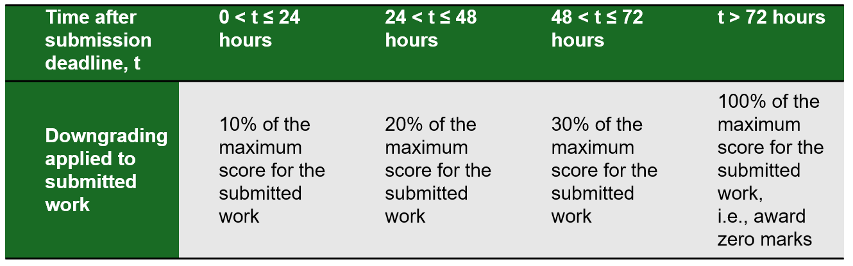
Administrative Matters
Penalties will be applied for late submissions.

Slide 11
Submissions
Final Assessment GA document released in Week 2
Milestone submissions:
  Milestone 1 - Week 6, submit in SA3 system
  Milestone 2 - Week 8, submit in SA3 system
FA Final submission, submit in SA3 system by week 11, Friday, 29 January 2026, 11:59 PM (2359H)
FA Interview: Week 12

Slide 12
Recommendations
You may submit your work in progress at any time before the submission deadlines for this assignment.
Do not wait till the last hour or minute to submit your work.
It is your responsibility to make regular backups of your work on your own HDD/thumb drives.

Slide 13
Graded Assignment Project Requirements Discussion
Refer to C372 FA Graded Assignment.pdf for detailed project requirements

Slide 14
Questions?

